Slide 1
The Partition of Bengal , 1905-1911 Dr. Saleh Shahriar NSU

Slide 2
Historical Background:
Bengal’s socio-economic configurations provided a crucial structural condition in which the Hindu–Muslim relations were articulated. The fact that the peasantry in east Bengal was predominantly Muslim and landlords largely Hindu remained important in organizing one community against another.

Slide 3
The permanent settlement of 1793
The Revolt of 1857
Formation of the Indian National Congress (1885)
Aligarh Movement led by Sir Syed Ahmed Khan
Toward the end of the 19th century, there was an emergence of a Hindu Revivalist Movement under Swami Vivekananda, Bankim Chandra Chatterji (Anandomath novel published in 1882 & Bande Matharam song in the novel ) and Bal Gangadhar Tilak from Maharastra. Tilak published a newspaper: Kesari. In his newspaper, Tilak was writing fiery articles propagating the supremacy of the Hindu Brahmin.
The Hindu Revivalist Movement was perhaps more anti-Muslim than anti-British (For details see, K.B. Sayeed, Pakistan: The Formative Phase, Oxford, p.21). Sri Aurobindo had begun the practice of Yoga in 1905.

Slide 4
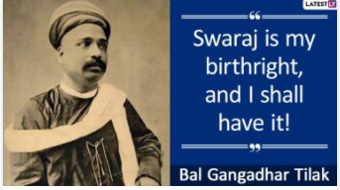
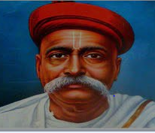

Slide 5
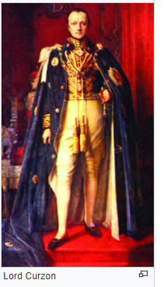
April 1902, Lord Carzon wrote to the Secretary of State regarding the question of provincial boundary. In his opinion Bengal was an area of nearly 200,000 squares miles with a population of 78.5 million, was too large a charge for a single man. He also pointed out that the district of East Bengal had been neglected and the neighboring province of Assam was too small for efficient administration.

Slide 6
In 1905 the British divided the huge province of Bengal into a western part (‘Bengal’) and an eastern part (‘Eastern Bengal and Assam’). See Map in the next slide.
The British government promised that :
“The partition of Bengal is a settled fact and it can by no means be unsettled.”

Slide 7
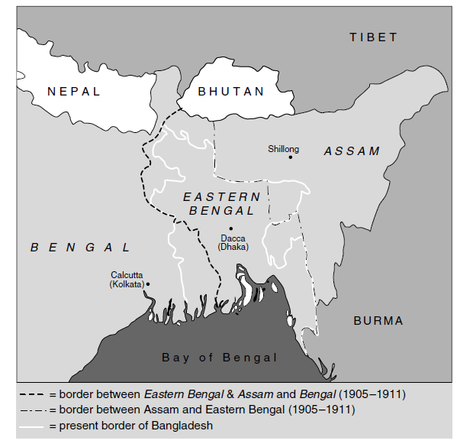
Eastern Bengal and Assam: Creation of a New Province

Slide 8
Why?
Administrative reasons/causes
‘Divide and Rule’ Policy
Economic reasons
Cultural reasons
Social reasons
Global colonial environment
Internal-External factors

Slide 9
Mixed Reactions:
A very vocal opposition developed, especially among the middle and upper classes in Kolkata. They feared a loss of economic power (tea and jute exports might now go through the port of Chittagong), inconvenience (east Bengal’s absentee landlords had settled in Kolkata) and competition (a new court system in east Bengal might exclude Kolkata lawyers and new newspapers might restrict the circulation of the Kolkata press).
Swadeshi movement by the Hindu Bhadralok to boycott British products and commodities
The Congress movement was largely led by Hindu lawers, merchants, and landlords who were determined to oppose the partition of Bengal because it would disrupt Kolkata’s commercial and professional life in which they had so much at stake.

Slide 10
The Swadeshi movement was part of the Indian independence movement and contributed to the development of Indian nationalism. Shadeshi Movement appealed to the Indian masses to use only goods produced in India. The Indian farmers were forced to produced indigos and cottons.
Swadeshi Movement has been characterized as cloth production in India. It originated from Bengal because the sentiments due to closed down domestic cloth industry was very high.
Use of Khadi instead of foreign cloths.

Slide 11
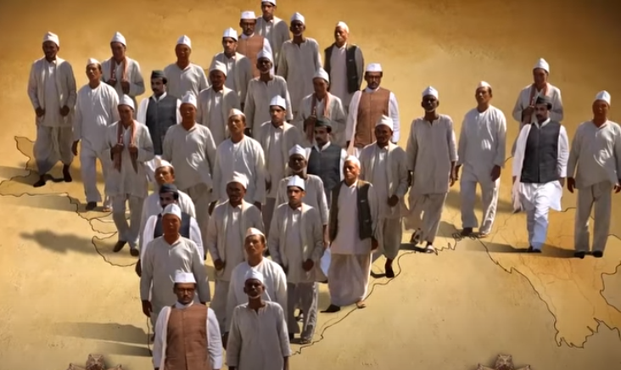

Slide 12
Historian professor Sumit Sarkar attempts a detailed study of a five-year period in Bengal's history (1903-1908) which despite its brief duration has come to occupy a very notable place in the historiography of nationalism and in the collective memory of our people. Apart from the abundant literature of biographies and memoirs, individual aspects of this anti-partition or Swadeshi Movement already have their historians, the main landmarks of political history have been adequately covered in numerous works on Indian nationalism, and growing access to the private papers of viceroys and officials have produced recently a spate of monographs on government policies in general . Bepinchandra Pal, Aurobindo Ghosh, Surendranath Banerji and Lala Lajpout Rai were very active in the anti-partition movement.

Slide 13
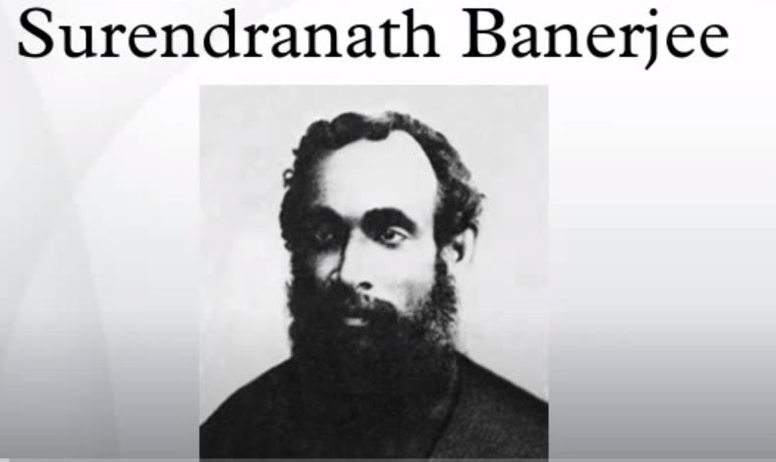

Slide 14
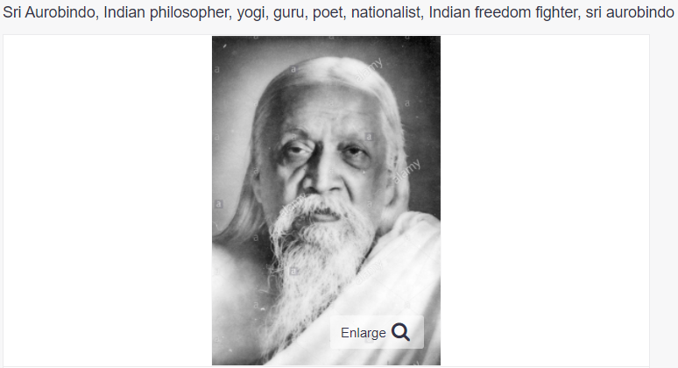

Slide 15
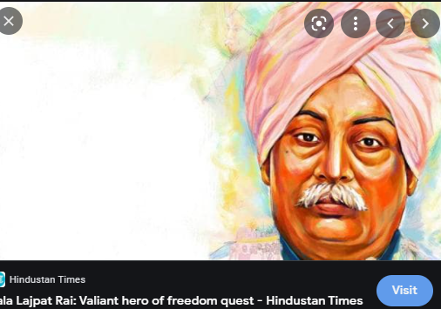

Slide 16


Following Tagore's call, hundreds of Hindus and Muslims in Kolkata, Dhaka and Sylhet came out in large numbers to tie Rakhi threads as a symbol of unity. Tagore's heartland Santiniketan still follows the tradition and the university students tied Rakhi to neighbours and common people to give a message of harmony

Slide 17

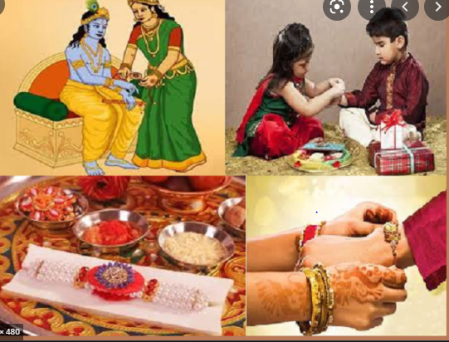

Slide 18

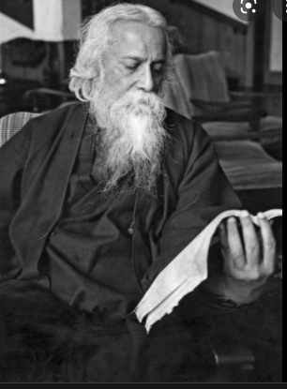

Slide 19
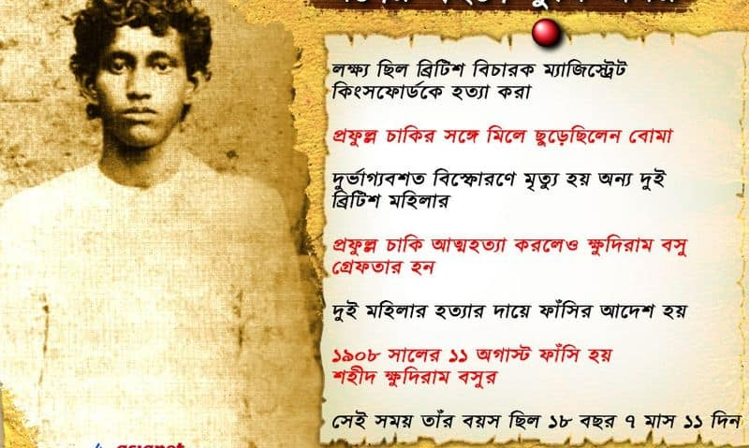

Slide 20
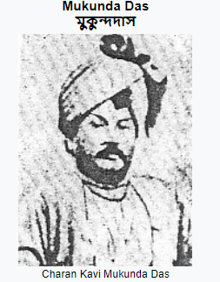

Slide 21
Support in favor of the partition plan came from different segment of the Muslims society. Signed by seven leading Muslim leaders, the Mohammedan Literary Society published a proposal in 1905 for a total support to the partition plan. In 1906, the Muslims organized an Islamic Conference in Dhaka as a move to emphasize their separate religious identity and to express reaction against the communal flavor of the Swadeshi Movement. Muslim organizations such as Anjuman-I-Mufidul, Islam Procharok etc. were in favor of the partition scheme.
The All-India Muslim League founded in 1906, supported the partition in totality.

Slide 22
Simla Deputation organized by the Indian Muslim leaders, met the Governor General and Viceroy Lord Minto in Simla on October 1906. Aga Khan and Nawab Ali Chowdhury were the key leaders . Shimla Deputation 1906 was first systematic attempt from Muslims side to represent their demand before British India.
Demands of the Muslim leaders were: a) preservation of a certain number of seats for Muslims in the municipal and district boards and in the university senate and syndicate; (b)separate election of Muslims to the Provincial council based on their political importance and not on the population ratio

Slide 23
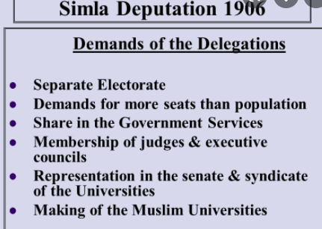
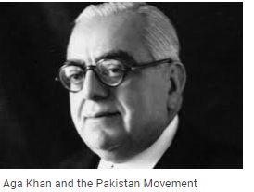

Slide 24
The debate over the separate and joint electorates as rival modes of election to the various representative institutions by the British began with the Simla deputation of 1906 and remained controversial till 1947. Not only was the issue controversial in the pre-Independent India, it also raises debates among contemporary historians and political scientists.
The recognition of the Muslims as separate electorate in Morley-Minto Reforms of 1909/ the India Act of 1909. The Morley-Minto reforms made a land mark towards the development of constitutional government. The Act, however, contributed to the growth of separatist politics in communal line.

Slide 25
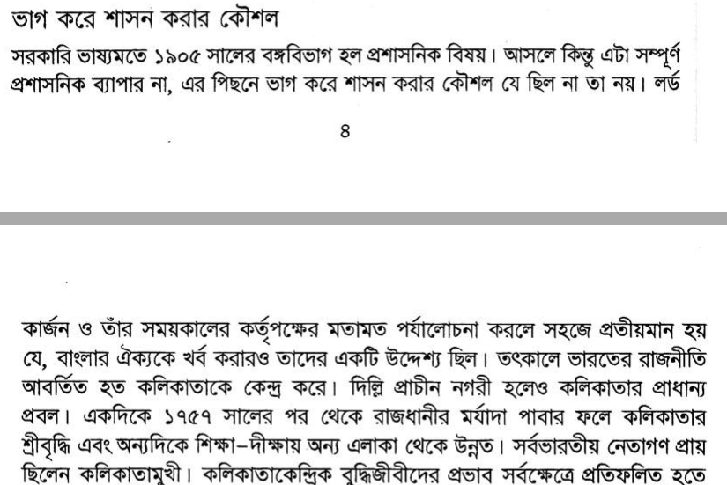
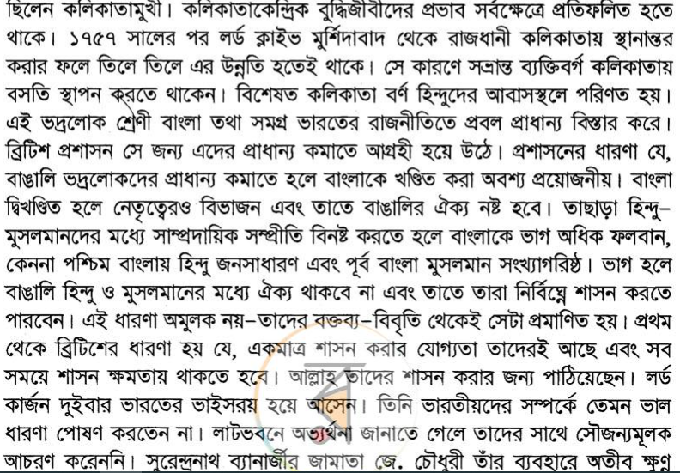

Slide 26
Annulment of the partition in 1911 ( by George V)
Recognition of the Muslim separate electorate in Morley-Minto Reforms of 1909
Bengali literature and cultural development
The birth of the All-India Muslim League, 1906
Hindu-Muslim communal conflicts
Educational and infrastructural development of the new province
The establishment of the University of Dhaka in 1921
Awareness of identity politics and nationalism
Growth of terrorism and communal violence (Formation of Anushilan Samiti, Jugantor etc.)

Slide 27
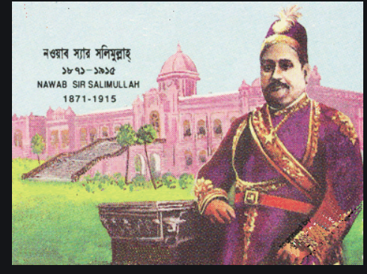

Slide 28

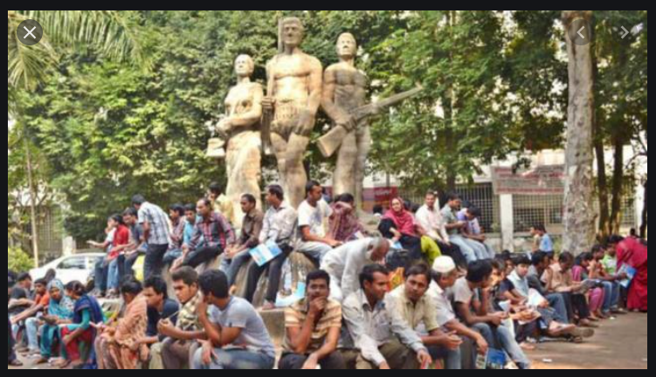
University of Dhaka

Slide 29
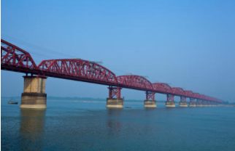
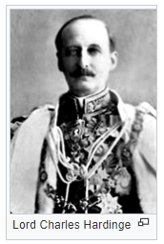

Slide 30
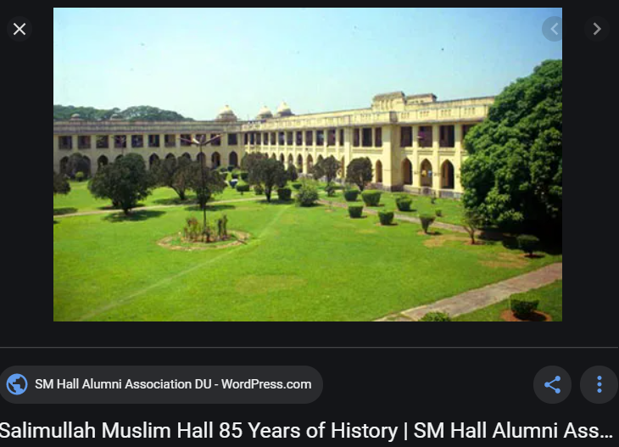

Slide 31
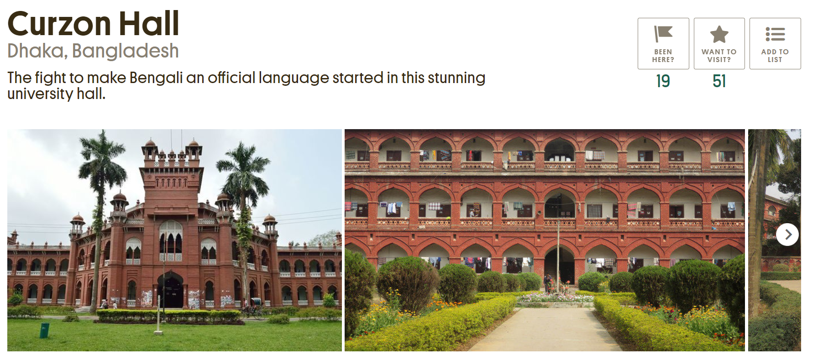
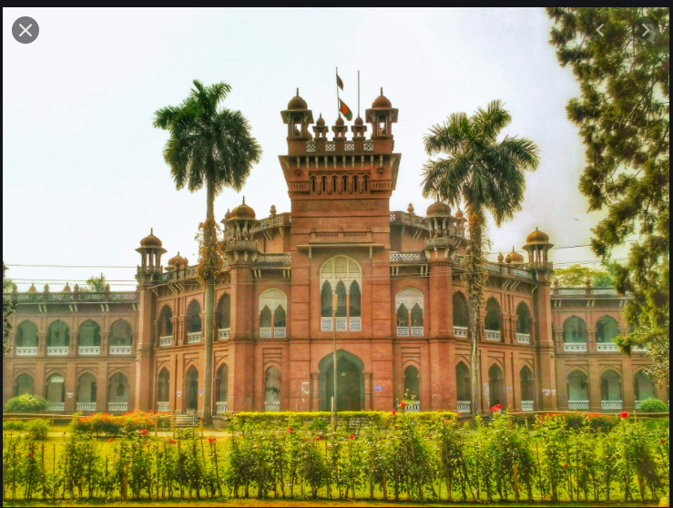

Slide 32
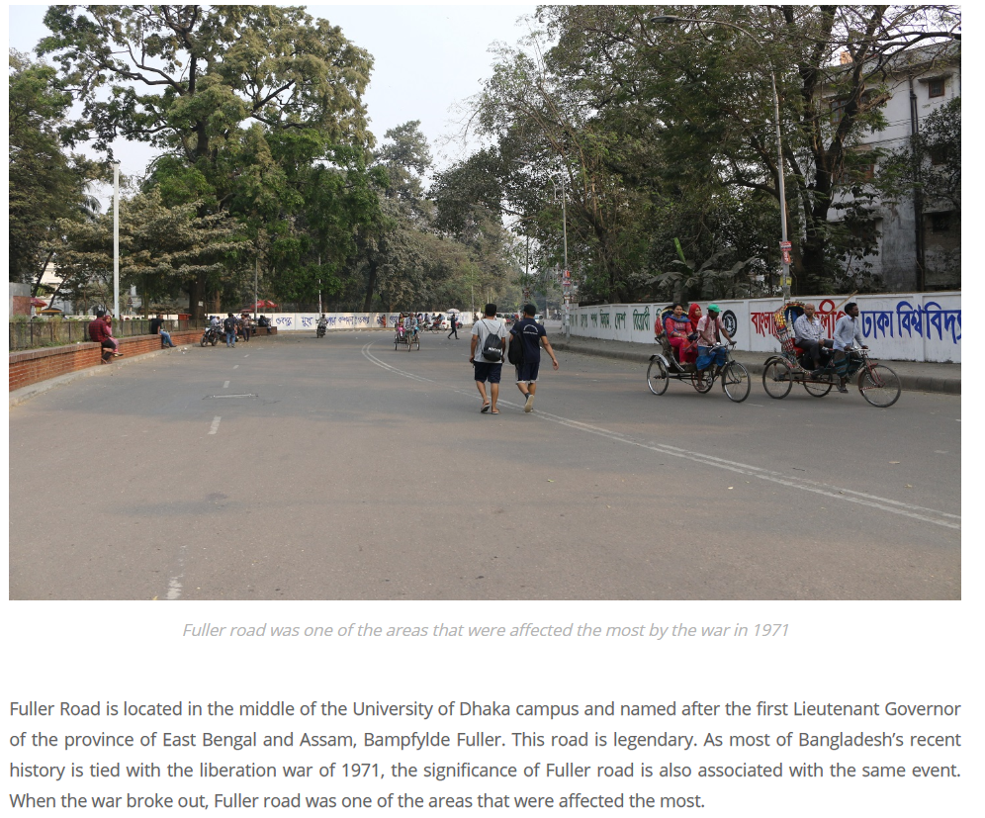
Fuller Road

Slide 33
Conclusions:
First world war, 1914-18
India Act of 1919/Montagu-Chelmsford reforms, 1919
Increase of Jute price in 2020s
Chauri Chaura Tragedy , 1922
Khilafat Movements , 1919-1924
Mohatma Gandhi and the Non-Violent Movement
Bengal Pacts, 1923
Nehru reports , 1928
Fourteen points of Jinnah , 1929
The Government of India Act, 1935
Quit India Movement, 1942
The Great Divide of 1947

